Slide 1
Introduction to the
Painted Essay®

Slide 2
Set Purpose
In this lesson:
I will learn about the structure of the Painted Essay.​
Notes:
Set Purpose
Today, we will learn about the structure of a basic essay, using a tool called the Painted Essay. This tool will show you how to organize your writing and help you better understand the characteristics of effective informative/explanatory and opinion pieces. We will use this tool throughout the year.
Display and read aloud the Student Learning Outcome.

Slide 3
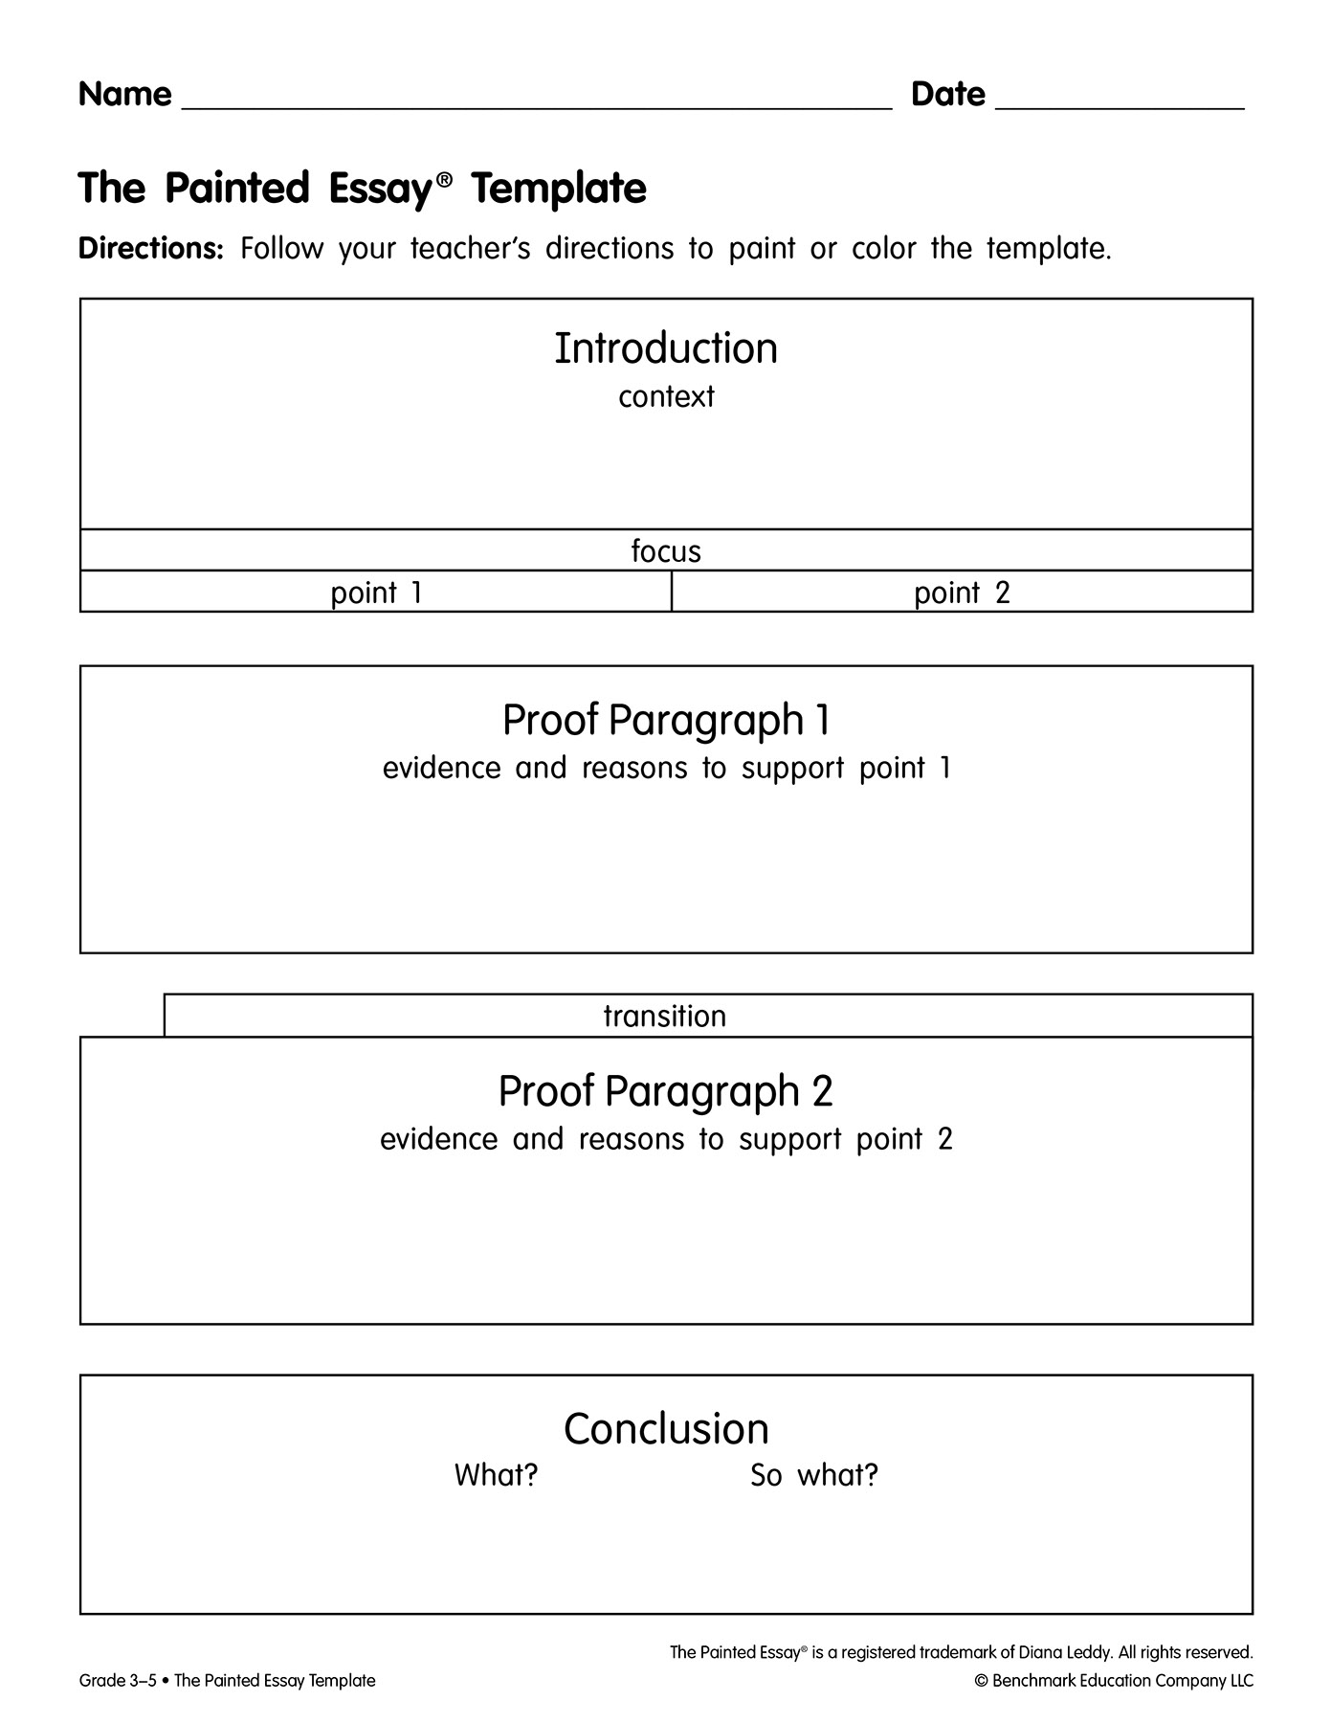
Introduce the Painted Essay
(20 Min.)
Collaborate
  Access your Painted Essay Template and coloring supplies.
  Each white rectangle represents a paragraph.
  How many paragraphs are in this essay?
Learning Outcome
  I will learn about the structure of the Painted Essay.
    Teach
        We will give each paragraph its own color to help us remember its name and purpose in the essay.
Notes:
Introduce the Painted Essay (20 min.)
Explain that an essay is a piece of writing that gives information or expresses the writer’s opinion on a particular topic. Today, students will
use color to help them remember the parts of an essay and understand how these parts work together to clearly explain the writer's thinking.
Have students access the Painted Essay Template Reproducible and their painting or coloring supplies.
Display the Painted Essay slide.
Tell students that each of the white rectangles represents a paragraph in the essay.
How many paragraphs are there in this essay? (four)
Explain that each of the four paragraphs has a name and special job or function.
We use color to help us remember the name of each paragraph and its purpose in the essay.

Slide 4
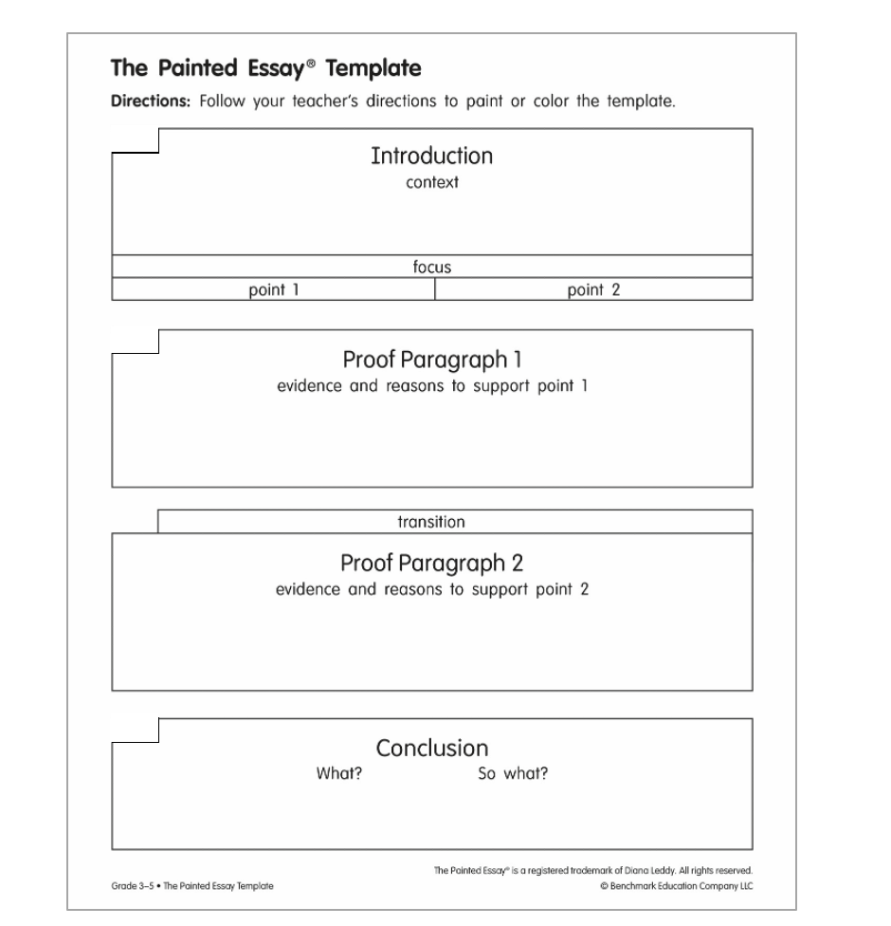
Introduce the Painted Essay
(20 Min.)
Collaborate
  Put your finger on the first paragraph.
Learning Outcome
  I will learn about the structure of the Painted Essay.
    Teach
        One of the jobs of the introduction is to give background information or context so the reader can understand the essay.
Notes:
Paint or Color the Introduction Context
Put your finger on the first paragraph on the page. This is the introduction.
Explain that one of the jobs of the introduction is to give background information, or context, so that the reader can understand the essay.

Slide 5
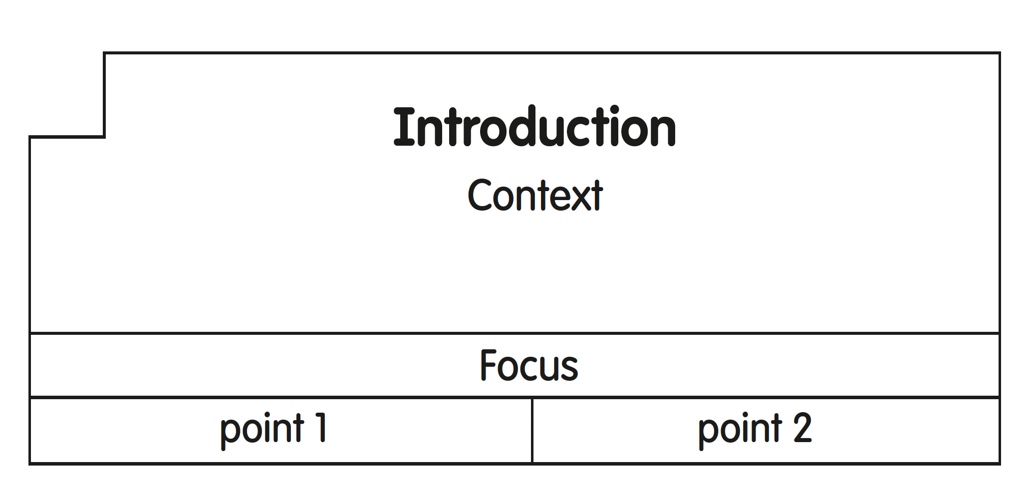
Introduce the Painted Essay
(20 Min.)
Collaborate
  Color or paint the context red.
Learning Outcome
  I will learn about the structure of the Painted Essay.
    Teach
        Red is a color that grabs your attention, so we’ll use red for the introduction.
Notes:
Paint or Color the Introduction Context
Tell students that the introduction should also catch the reader’s attention, so they want to keep reading.
Red is a color that grabs our attention, so we will lightly shade the context part of the introduction red.
Model painting or coloring the top part of the template of the introduction, stopping at the line over the word focus. Remind students to be careful not to paint or color the focus statement yet.
Direct the students to paint or color this paragraph red.
Put your brush (or colored pencil) down when you are done.
Give students a few minutes to color the introduction.
Please put your brushes (or pencils) down. If you have not finished coloring or painting, you will get time at the end of the lesson to finish.

Slide 6
Introduce the Painted Essay
(20 Min.)
Collaborate
  Color or paint the focus green.
Learning Outcome
  I will learn about the structure of the Painted Essay.
    Teach
        The focus statement is the most important part of your essay. This sentence drives your piece like the steering wheel of a car. This sentence tells the central idea of your piece, what your piece will be about.
Notes:
Introduce the Painted Essay
Focus Statement
Direct students to the focus statement at the end of the introduction.
The focus statement is the most important part of your essay. It drives your piece like the steering wheel of a car. The focus statement tells the reader what your piece will be about.
Explain that a focus statement has three parts that work together. The first part is the focus, which tells the central idea of the piece.
Instruct students to lightly paint or color the focus part of the template with green. Students should still be able to read the word focus underneath the color.
Put your brush (or colored pencil) down when you are done.

Slide 7
Introduce the Painted Essay
(20 Min.)
Collaborate
  Paint or color point 1 yellow.
  Paint or color point 2 blue.
  What color do yellow and blue make?
  Paint or color a green line around the elements of the focus statement.
Learning Outcome
  I will learn about the structure of the Painted Essay.
    Teach
        There are different parts to the focus statement that work together to tell the reader the main idea of the piece.
        In addition to the focus that tells them the main idea, the focus statement has two points that are used to support it: point 1 and point 2.
        The focus statement is composed of three parts: the focus, point 1, and point 2. Paint (or draw) a line boxing these three parts together to show this.
Notes:
Introduce the Painted Essay
Focus Statement
Explain that in addition to the focus that tells the central idea, the focus statement has two points that are used to support it: point 1 and point 2.
Model painting or coloring “point 1” yellow and “point 2” blue. Instruct students to paint or color "point 1" yellow and "point 2" blue.
What color do yellow and blue make? (Sample response: green)
Explain that point 1 and point 2 work together to help the reader understand the central idea of the piece.
The focus statement is composed of three parts: the focus, point 1, and point 2. Paint (or draw) a line boxing these three parts together.
Model painting or coloring a line around the three elements of the focus statement: the focus, point 1, and point 2. Instruct students to do the same.
Put your brush (or colored pencil) down when you are done

Slide 8
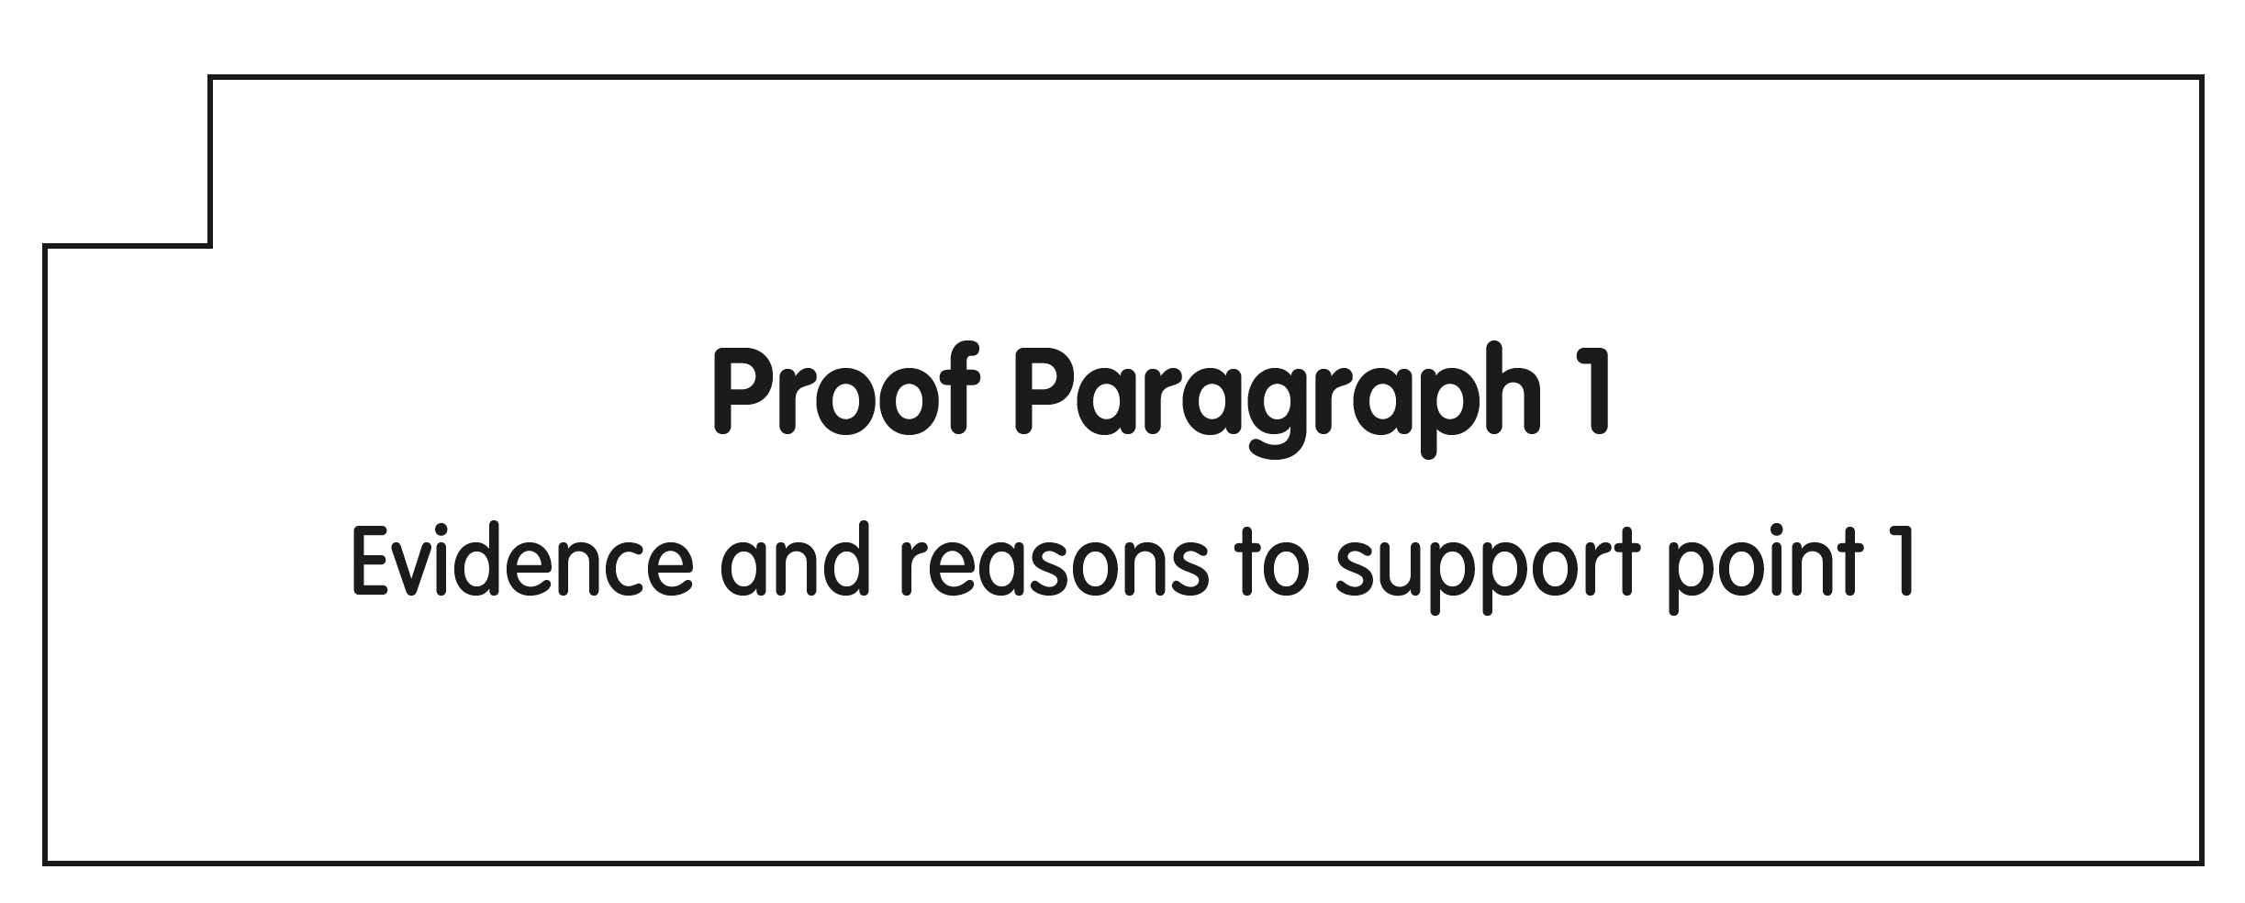
Introduce the Painted Essay
(20 Min.)
Collaborate
  Put your finger on the second paragraph.
  What color do you think we should color/paint proof paragraph 1 and why?
  Color or paint proof paragraph 1 yellow.
Learning Outcome
  I will learn about the structure of the Painted Essay.
    Teach
        The job of proof paragraph 1 is to give evidence and reasons to support the first point of the focus statement.
Notes:
Introduce the Painted Essay
Paint or Color Proof Paragraph 1
Put your finger on the second paragraph in your essay. This next paragraph is called proof paragraph 1.
Explain that the job of proof paragraph 1 is to give evidence and reasons to support the first point of the focus statement.
What color do you think we should paint proof paragraph 1 and why? (yellow, because it goes with point 1 of the focus statement)
Model painting or coloring the rectangle for “proof paragraph 1” yellow.
Instruct students to lightly paint or color “proof paragraph 1” yellow.
Put your brush (or colored pencil) down when you are done.

Slide 9
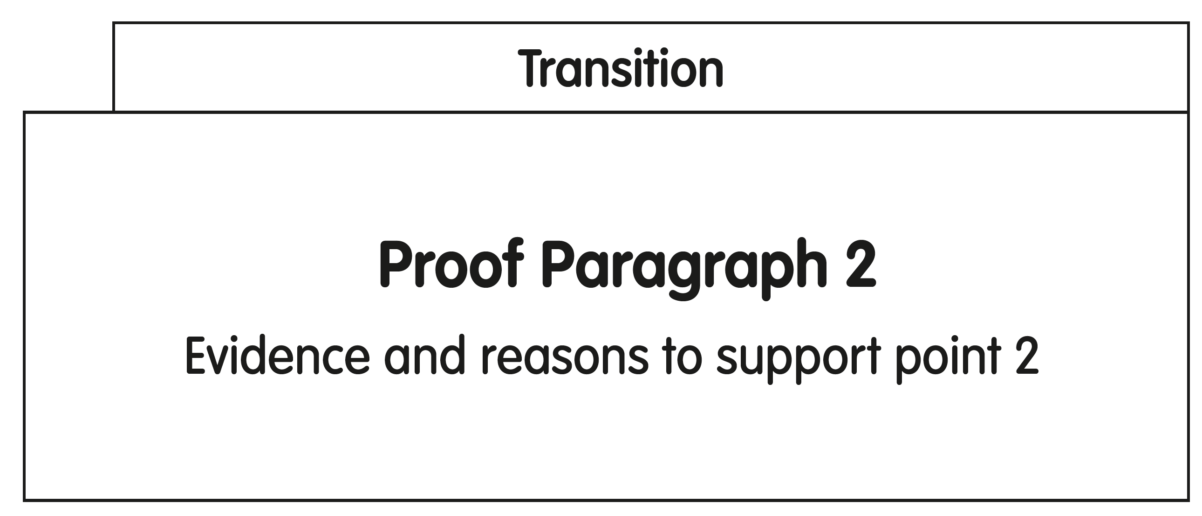
Introduce the Painted Essay
(20 Min.)
Collaborate
  Put your finger on the third paragraph.
  What color should we paint or color proof paragraph 2?
  Color or paint proof paragraph 2 blue.
Learning Outcome
  I will learn about the structure of the Painted Essay.
    Teach
        At the beginning of proof paragraph 2, there is a special sentence called a transition. We will come back to the transition. First, you will learn about proof
        paragraph 2.
Notes:
Introduce the Painted Essay
Paint or Color Proof Paragraph 2
Put your finger on the third paragraph in your essay. This is proof paragraph 2.
Explain that at the beginning of proof paragraph 2, there is a special sentence called a transition. Tell students that they will come back to the transition. First, they will learn about proof paragraph 2.
Explain that the job of proof paragraph 2 is to give evidence and reasons to support the second point of the focus statement.
What color should we paint proof paragraph 2 and why? (blue, because it goes with point 2 of the focus statement)
Model painting or coloring the rectangle for proof paragraph 2 blue.
Instruct students to skip the transition and lightly paint or color the proof paragraph 2 part of the template with blue just like point 2 of their focus.
Put your brush (or colored pencil) down when you are done.

Slide 10
Introduce the Painted Essay
(20 Min.)
Collaborate
  Put your finger on the transition.
  Color or paint the transition yellow and blue.
Learning Outcome
  I will learn about the structure of the Painted Essay.
    Teach
        This sentence is called a transition. A transition sentence moves the reader from one big point in your piece to the next.
        iELD: See notes.
Notes:
Introduce the Painted Essay
Transition
Direct students back to the transition part of the template.
This line is called a transition. A transition is a sentence that moves the reader from one big point in your piece to the next.
Elaborate that the transition is a sentence that has the job to bridge the ideas in the yellow proof paragraph 1 and the blue proof paragraph 2, so it should be painted yellow and blue.
Model painting or coloring the transition yellow and blue. Explain that students should try not to mix the colors, but rather both colors should be included in the transition line.
Instruct students to color the transition yellow and blue.
iELD: Total Physical Response: Engage students in TPR to support their understanding of the word transition.
Total Physical Response:
transition: Have students stand up, take one side-step to the right, and sit back down. Explain that they transitioned or moved from one place to another.
Invite students to repeat the actions while saying the word.
ELD.PI.3.10

Slide 11
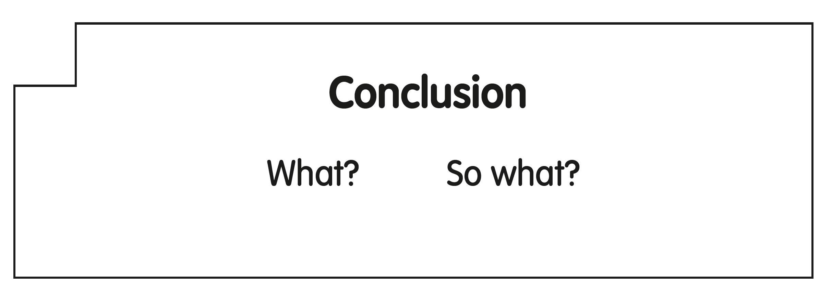
Introduce the Painted Essay
(20 Min.)
Collaborate
  Put your finger on the last paragraph.
  Mix yellow and blue to combine these ideas and see what you get.
  Lightly paint or color the conclusion a unique shade of green.
Learning Outcome
  I will learn about the structure of the Painted Essay.
    Teach
        This is the conclusion. In the conclusion, you want to remind the reader of your focus, the “What?” but also add in your own thinking about why what you said is important, the “So What?”
        If you look around, you’ll see lot’s of different shades of green. These shades are like our ideas, unique.
Notes:
Introduce the Painted Essay
Paint or Color the Conclusion
Put your finger on the last paragraph in your essay. This is the conclusion.
Explain that the name of the last paragraph is the conclusion. Its job is to wrap up the piece and it has two parts: a “What?” and a “So What?”
In your conclusion, you want to remind the reader of your focus, the “What?" but also add in your own thinking about why what you said is important, the “So What?”
Explain that in their conclusion, students remind the reader of the ideas in proof paragraph 1 and proof paragraph 2, and add their own thinking about the topic. Instruct students to mix yellow and blue to combine these ideas and see what they get.
Tell students to look around the classroom and observe the many different shades of green their classmates have made for their conclusions. Explain that this demonstrates that even if everyone is working with similar information from the texts, each person will have their own ideas and insights about that information. The conclusion is a unique shade of green, just like their own unique thinking.
Model painting or coloring the conclusion rectangle green.
Instruct students to lightly paint or color the conclusion part of the template with their own unique shade of green.
Put your brush (or colored pencil) down when you are done.

Slide 12
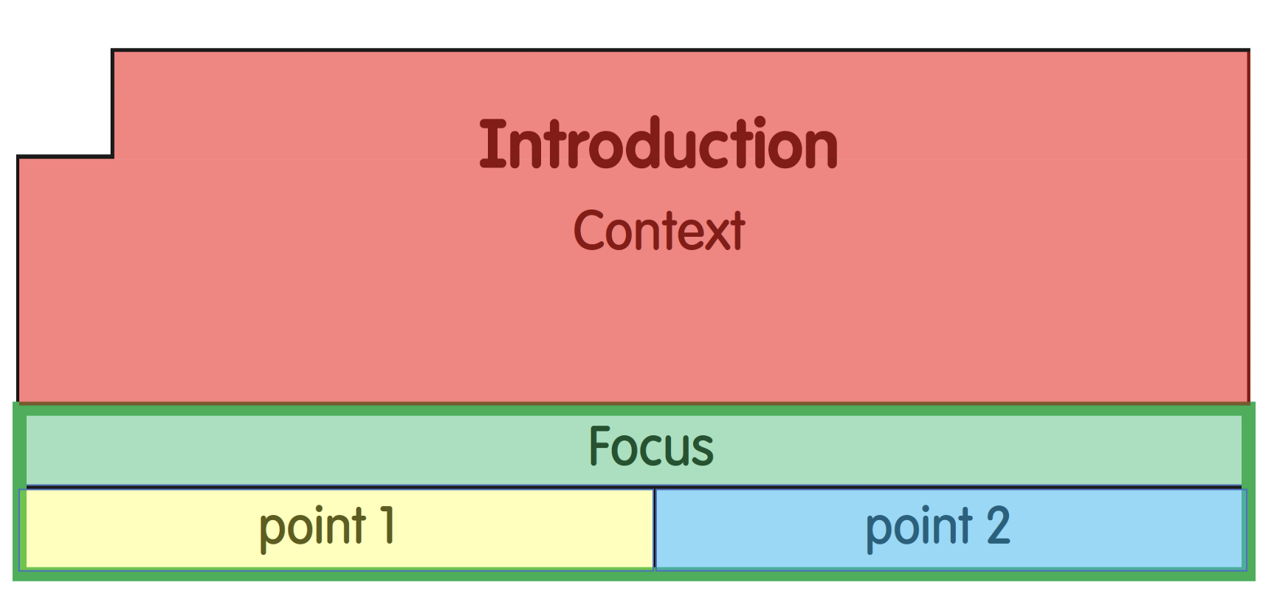
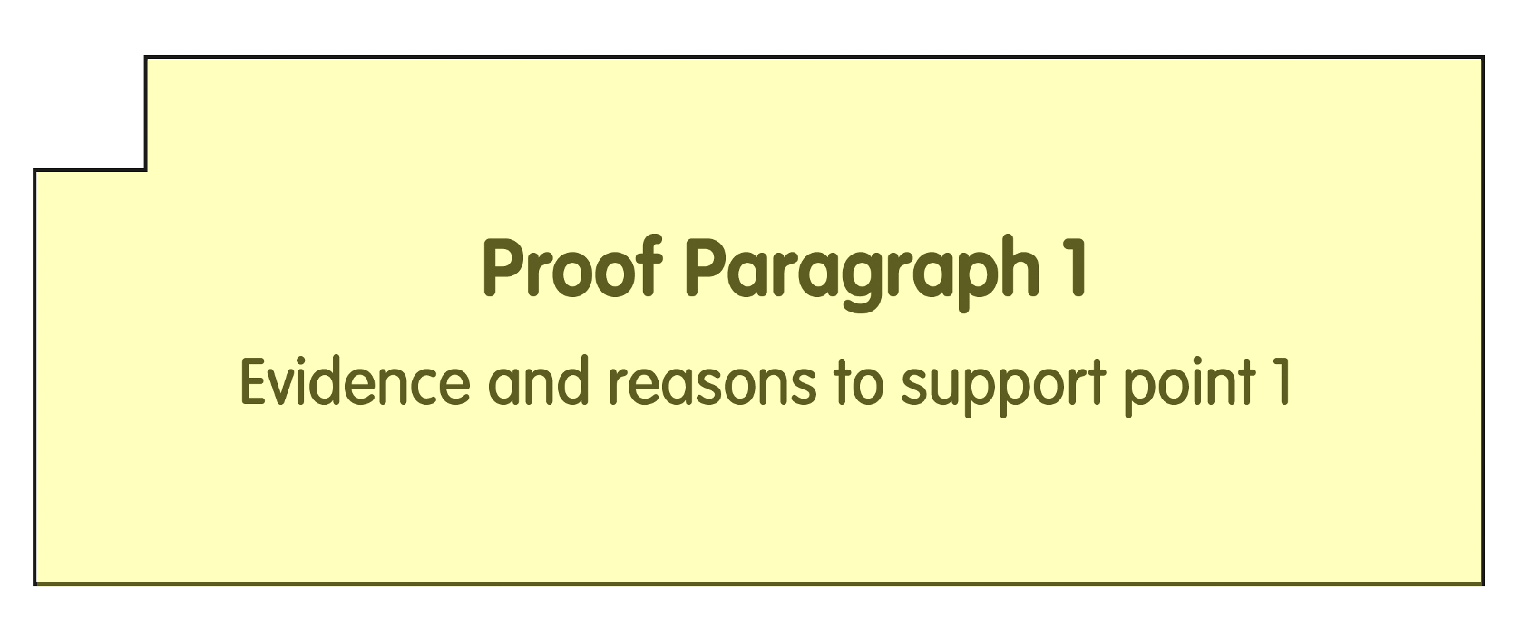
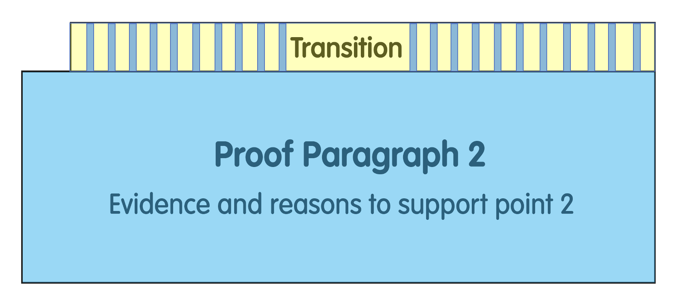
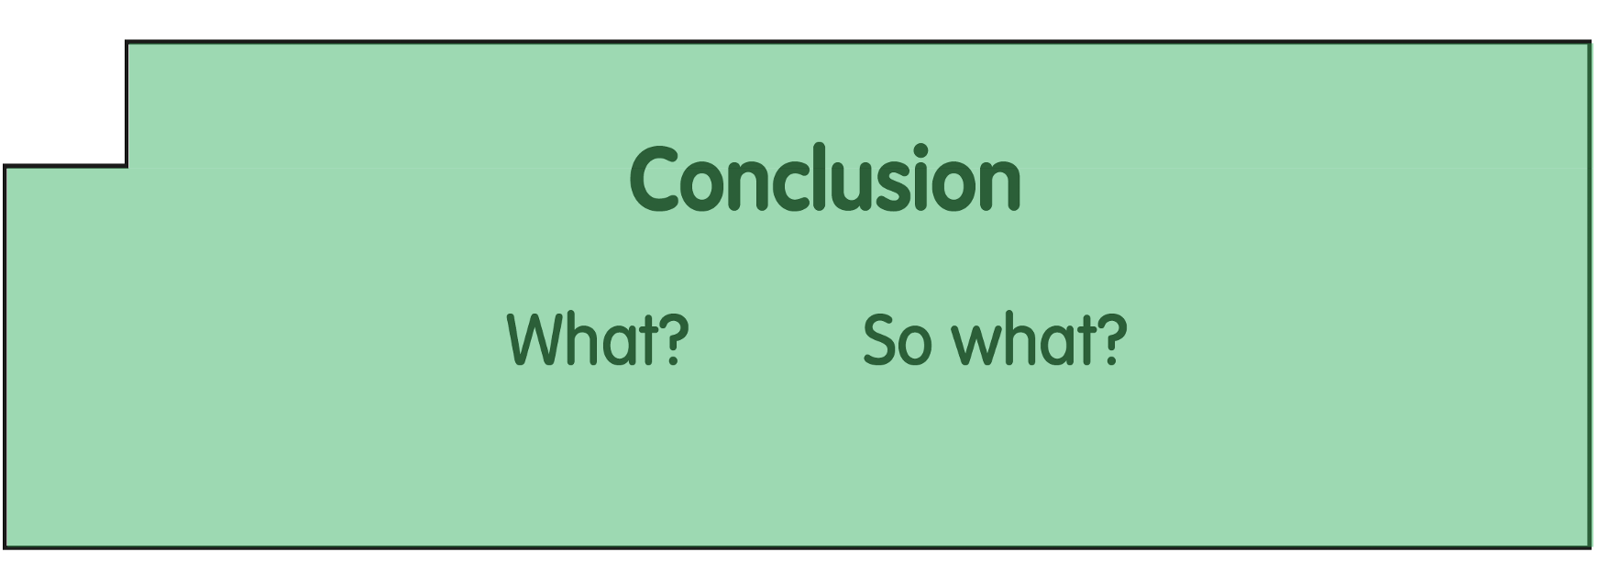
Debrief the Painted Essay
(9 Min.)
Collaborate
  Show your partner the paragraph that has the job of wrapping up the essay.
  Why is it colored green?
Learning Outcome
  I will learn about the structure of the Painted Essay.
Notes:
Debrief the Painted Essay (9 min.)
To continue building our writing community, you will work in partners to reinforce what you learned today about the Painted Essay.
Ask questions like the following to review the parts of the the Painted Essay. Instruct students to share their answers with their partners before confirming the correct answer with the whole class.
With your finger, show your partner the paragraph that has the job of wrapping up the essay. (conclusion—green part) Why is this colored green? (because its job is to remind the reader of the focus and add your own unique thinking)

Slide 13
Debrief the Painted Essay
(9 Min.)
Collaborate
  Show your partner the part that has the job of giving the reader background information.
  What color is it and why?
  Show your partner the part of the essay that tells the reader what the piece will be about. It includes the central idea of your piece and two points.
  What colors are in the focus statement?
Learning Outcome
  I will learn about the structure of the Painted Essay.
Notes:
Debrief the Painted Essay (9 min.)
With your finger, show your partner the part that has the job of giving the reader background information, or context, so the reader can understand the piece. What color is it and why? (introduction—red part, catches the reader's attention)
With your finger, show your partner the part of the essay that tells the reader what the piece will be about. It includes the central idea of your piece and two points. (focus statement) What colors are in the focus statement? (green, yellow, and blue)

Slide 14
Debrief the Painted Essay
(9 Min.)
Collaborate
  Show your partner the part that has the job of being a bridge between your two points.
  What colors are in the transition? Why?
Learning Outcome
  I will learn about the structure of the Painted Essay.
Notes:
Debrief the Painted Essay (9 min.)
With your finger, show your partner the part that has the job of being a bridge between your two points. (transition) What colors are in the transition? (yellow and blue) Why is the transition yellow and blue? (It moves the reader from the ideas in your yellow paragraph to the ideas in your blue paragraph.)

Slide 15
Debrief the Painted Essay
(9 Min.)
Collaborate
  Show your partner the part that has the job of giving evidence and reasons to support the first point in your focus statement.
  What color is this paragraph? Why?
  Show your partner the part that has the job of giving evidence and reasons to support the second point in your focus statement.
  What color is this paragraph? Why?
Learning Outcome
  I will learn about the structure of the Painted Essay.
    Teach
        Access: See notes.
        iELD: See notes.
        Extend: See notes.
Notes:
Debrief the Painted Essay (9 min.)
With your finger, show your partner the part that has the job of giving evidence and reasons to support the first point in your focus statement. (proof paragraph 1) What color is this paragraph? Why? (yellow, to match the yellow point in the focus statement)
With your finger, show your partner the part that has the job of giving evidence and reasons to support the second point in your focus statement. (proof paragraph 2) Why is it blue? (to match the blue point in the focus statement)
Confirm that students understand that the Painted Essay has four paragraphs: the introduction, proof paragraph 1, proof paragraph 2, and conclusion. These parts together form a complete essay. The colors can help students remember each paragraph and understand how the paragraphs work together to make meaning.
ACCESS: Conduct a Think-Aloud to support students as they identify different parts of the Painted Essay.
Think-Aloud
If students need additional support reinforcing what they've learned, model how to use the color-coding and purpose of each paragraph to identify parts of the Painted Essay.
Think aloud by scanning the essay and asking:
I’m looking for the part that wraps up the essay. I know the conclusion reminds the reader of the main idea and adds a final thought. I also remember the conclusion is green.
Point to the correct section and continue:
This must be the conclusion because it matches the job and the color.
Prompt students to apply this strategy by asking:
What is the job of this part? What color should it be?
Have students use both the job and the color-coding to locate each part before sharing with a partner.
iELD: Leverage Linguistic Assets: Encourage students to use their home languages, if helpful, as they review the concepts of the Painted Essay.
For example: Would you like to use your home language as you review the parts of the essay and discuss the meaning of the colors with your partner?
EXTEND: Ask Guiding Questions to challenge students in orally sharing the purpose of the Painted Essay.
Guiding Questions
Challenge students to orally share the job of each paragraph and respond to these questions:
If we took away the introduction, what would happen to the essay?
What would happen if we switched the proof paragraphs?
Why does the conclusion need to restate the main idea instead of adding new facts?

Slide 16

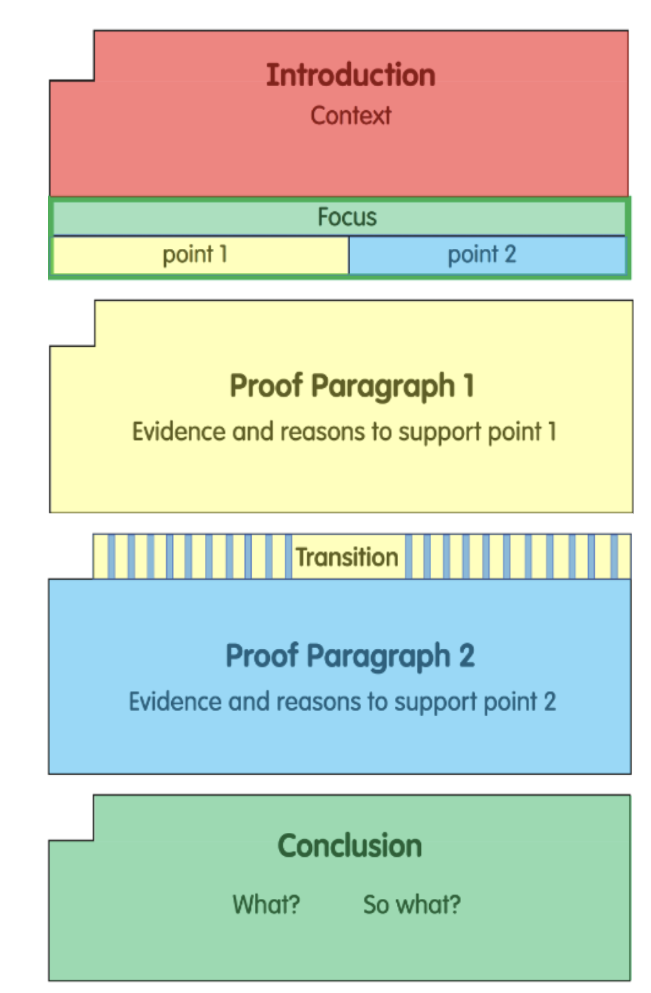
Wrap Up
(9 Min.)
Collaborate
Learning Outcome
  I will learn about the structure of the Painted Essay.
    Teach
        Congratulations on your work!
        In the next writing lesson, you will use the Painted Essay to help analyze a model of an informative/explanatory essay.
        Assess: See notes.
What is one thing you learned or found interesting about the Painted Essay?
Turn and Talk
  Listen
  Think
  Turn
  Talk
Turn and Talk
  Listen
  Think
  Turn
  Talk
Notes:
Wrap Up (1 min.)
Have students use the Turn and Talk Protocol to share one thing they learned or found interesting about the Painted Essay.
Congratulate students on their work today. Explain that tomorrow they will use the Painted Essay structure to analyze a model informative/explanatory essay.
Formative Assessment: Look Fors
ASSESS: Prior to the next writing lesson, review students’ the Painted Essay Templates. Did students:
Correctly paint or color the different parts of the essay?
Correctly identify each part and its purpose in the essay?
As needed, provide additional support during the next writing lesson.
Have students save their templates of the Painted Essay to refer to throughout the school year. If possible, laminate the templates or put them in a sheet protector.

Slide 17
Wrap Up
In this lesson:
I will learn about the structure of the Painted Essay.

